Slide 1
KS2 MULTIPLICATION & DIVISION
Wednesday 8th May

Slide 2
Aims of the session
Key Learning Points from KS1
Structures of Multiplication
Where do they come from?
The root of it all…the importance of mental recall
Written methods we have chosen for Hayward’s
Where do they finish?

Slide 3
Unitising
Children need to see each group as a whole/unit.
How many plants are there? How could children see this? How could they solve it?

Slide 4
Key Points from Key Stage 1
Multiplication and division are related – they are the inverse
You can use multiplication to solve division calculations
Multiplication is commutative: 3 x 4 = 4 x 3
Division is not commutative: 6 ÷ 3 $≠$ 3 ÷ 6

Slide 5
Thinking point: Is 7 x 3 the same as 3 x 7?
The product is the same
The factors are the same
Children are put into 7 groups of 3 in one class and 3 groups of 7 in another. Is that the same? How is it the same? How is it different?
Children need to recognise the difference in some contexts.

Slide 6
Aims of the session
Key Learning Points from KS1
Structures of Multiplication
Where do they come from?
The root of it all…the importance of mental recall
Written methods we have chosen for Hayward’s
Where do they finish?

Slide 7
Structures of Multiplication
Grouping / Repeated Addition
Number in group x number of
groups. Groups are equal.
Correspondence
I have 3 hats and 2 scarves. How many combinations can I wear? (Year 3 and 4)
Scaling
My dog weighs 10kg. My brother’s dog weighs 3 times the amount. (Fractions)

Slide 8
Aims of the session
Key Learning Points from KS1
Structures of Multiplication
Where do they come from?
The root of it all…the importance of mental recall
Written methods we have chosen for Hayward’s
Where do they finish?

Slide 9
What is expected at the end of KS1?

Slide 10
What is expected at the end of KS1? Applying the Skills in Context

Slide 11
What is expected at the end of KS1? Applying the Skills in Context

Slide 12
Aims of the session
Key Learning Points from KS1
Structures of Multiplication
Where do they come from?
The root of it all: the importance of mental recall
Written methods we have chosen for Hayward’s
Where do they finish?

Slide 13
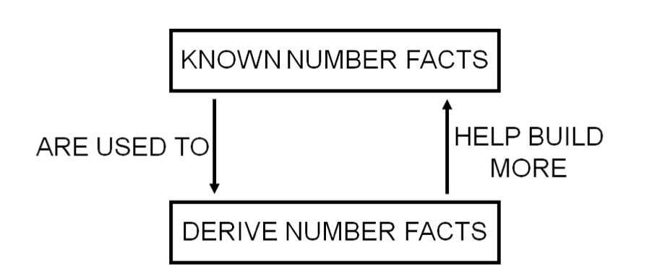
The Root of it All

Slide 14
Key Skills
KNOWN FACTS
Counting in groups (Clever Counting)
Doubling and Halving
Grouping / Multiplication and Division facts

Slide 15
3 x 8 = 24

Slide 16
Raises confidence
Develops knowledge
Knowledge builds understanding
Breaks down barriers

Slide 18
Aims of the session
Key Learning Points from KS1
Structures of Multiplication
Where do they come from?
The root of it all: the importance of mental recall
Written methods we have chosen for Hayward’s
Where do they finish?

Slide 19
In Summary
 | Multiplication | Division
Year 3 | MAKE CONNECTIONS Focus on develop mental methods and understanding of concept. Formalise into grid multiplication from work with arrays. | MAKE CONNECTIONS Connect division to multiplication, solving division calculations through multiplication and the use of a number line. Use halving where appropriate.
Year 4 | Continue to develop conceptual understanding. By end of year, use formal short multiplication where children can explain process. | Continue to develop division through multiplication and number lines. Introduction to the formal method with partitioning.
Year 5 | Use the formal column method for calculations. Encourage use of mental methods and informal methods to supplement. | Use short division. Convert remainders to fractions and develop and understanding of why.
Year 6 | Use formal column methods. | Use short division and alternative long division method.

Slide 20
Year 3

Slide 21
Year 4

Slide 22
Year 5

Slide 23
Year 6

Slide 24
Aims of the session
Key Learning Points from KS1
Structures of Multiplication
Where do they come from?
The root of it all: the importance of mental recall
Written methods we have chosen for Hayward’s
Where do they finish?

Slide 29
Thank you for coming!

