Slide 1
KS2 Addition and Subtraction
13.3.19

Slide 2
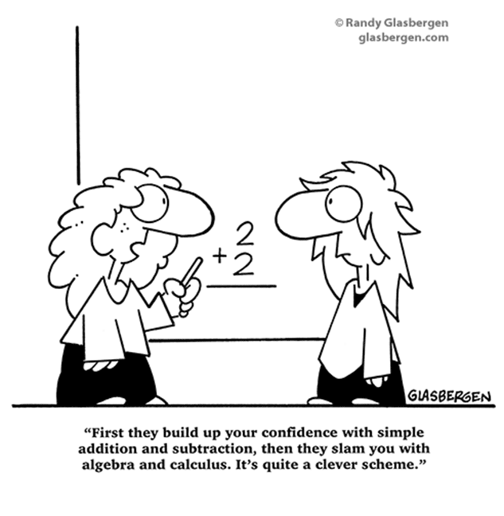
Aims for this session
“This isn’t how I was taught
at school….”
Aims / Changes of the New Curriculum
The importance of mental and written methods of calculation
Have fun!

Slide 3
Aims
The national curriculum for mathematics aims to ensure that all pupils:
• become fluent in the fundamentals of mathematics, including through varied and frequent practice with increasingly complex problems over time, so that pupils develop conceptual understanding and the ability to recall and apply knowledge rapidly and accurately.
• reason mathematically by following a line of enquiry, conjecturing relationships and generalisations, and developing an argument, justification or proof using mathematical language
• can solve problems by applying their mathematics to a variety of routine and non-routine problems with increasing sophistication, including breaking down problems into a series of simpler steps and persevering in seeking solutions

Slide 4
Key Principles
Written methods of calculations are based on mental strategies.
Each of the four operations builds on mental skills which provide the foundation for jottings and informal written methods of recording.
Skills need to be taught, practised and reviewed constantly. These skills lead on to more formal written methods of calculation.
Strategies for calculation need to be represented by models and images to support, develop and secure understanding. This, in turn, builds fluency.
The transition between stages should not be hurried as not all children will be ready to move on to the next stage at the same time; therefore, the progression in this document is outlined in stages.
Previous stages may need to be revisited to consolidate understanding when introducing a new strategy.
A sound understanding of the number system is essential for children to carry out calculations efficiently and accurately.

Slide 5
The importance of fluency
Efficiency - this implies that children do not get bogged down in too many steps or lose track of the logic of the strategy. An efficient strategy is one that the student can carry out easily, keeping track of sub-problems and making use of intermediate results to solve the problem. Accuracy depends on several aspects of the problem-solving process, among them careful recording, knowledge of number facts and other important number relationships, and double-checking results. Flexibility requires the knowledge of more than one approach to solving a particular kind of problem, such as two-digit multiplication. Students need to be flexible in order to choose an appropriate strategy for the numbers involved, and also be able to use one method to solve a problem and another method to check the results.

Slide 6
What have been the main changes in the teaching and learning of Maths?
Mastery of a content – no acceleration on to new / higher year group content Reasoning - the expectation that children can explain their thinking and show their understanding in multiple ways
Speaking in full sentences – children have to speak in full sentences throughout Maths lessons and explain their reasoning
Perception of high ability – number crunchers are not necessarily the best mathematicians

Slide 8
Apparatus, resources and imagery for all learners
SHOW IT
DRAW IT
EXPLAIN IT
TELL IT

Slide 9
What is expected at the end of KS2?

Slide 10
What is expected at the end of KS2? Applying the Skills in Context

Slide 11
Key language for addition: sum, total, parts and wholes, plus, add, altogether, more, ‘is the same as’ Key language for subtraction: take away, subtract, find the difference, fewer, less than

Slide 14
Have a go! Year 3 and 4 Mental Methods
346 – 306 = ________
____ = 86 – 39
567 + 199 = _______
_____= £2 – 36p
600 – _____ = 237
365 + 423 = ________

Slide 17
Have a go! Year 3 and 4 Written Methods
4567 + 3825 = ______
_____ = £10 – 3.67
517 – 238 = _______

Slide 20
Have a go! Year 5 and 6 Mental Methods
567809 –______ = 560809
______ = 45.65m – 3.99m
59998 + 45629 = _______
_____= £20 – 3.56p
60000 – _____ = 23000
5.67 + 3.98 = ________

Slide 23
Have a go! Year 5 and 6 Written Methods
356768 + 73285 = ______
_____ = £200 – 67.26
517956 – _____ = 45657

Slide 24
Thank you for coming!

