Slide 1

KS1 Addition and Subtraction
20.3.19

Slide 2
Aims for this session
Aims / Changes of the New Curriculum
Progression in Addition and Subtraction
Calculation Policy in Year 1 and 2
Have fun!

Slide 3
Aims
The national curriculum for mathematics aims to ensure that all pupils:
• become fluent in the fundamentals of mathematics, including through varied and frequent practice with increasingly complex problems over time, so that pupils develop conceptual understanding and the ability to recall and apply knowledge rapidly and accurately.
• reason mathematically by following a line of enquiry, conjecturing relationships and generalisations, and developing an argument, justification or proof using mathematical language
• can solve problems by applying their mathematics to a variety of routine and non-routine problems with increasing sophistication, including breaking down problems into a series of simpler steps and persevering in seeking solutions

Slide 4
Key Principles
Written methods of calculations are based on mental strategies.
Each of the four operations builds on mental skills which provide the foundation for jottings and informal written methods of recording.
Skills need to be taught, practised and reviewed constantly. These skills lead on to more formal written methods of calculation.
Strategies for calculation need to be represented by models and images to support, develop and secure understanding. This, in turn, builds fluency.
The transition between stages should not be hurried as not all children will be ready to move on to the next stage at the same time; therefore, the progression in this document is outlined in stages.
Previous stages may need to be revisited to consolidate understanding when introducing a new strategy.
A sound understanding of the number system is essential for children to carry out calculations efficiently and accurately.

Slide 5
The importance of fluency
Efficiency - this implies that children do not get bogged down in too many steps or lose track of the logic of the strategy. An efficient strategy is one that the student can carry out easily, keeping track of sub-problems and making use of intermediate results to solve the problem.
Accuracy depends on several aspects of the problem-solving process, among them careful recording, knowledge of number facts and other important number relationships, and double-checking results.
Flexibility requires the knowledge of more than one approach to solving a particular kind of problem, such as two-digit multiplication. Students need to be flexible in order to choose an appropriate strategy for the numbers involved, and also be able to use one method to solve a problem and another method to check the results.

Slide 6
What have been the main changes in the teaching and learning of Maths?
Mastery of a content – no acceleration on to new / higher year group content
Reasoning - the expectation that children can explain their thinking and show their understanding in multiple ways
Speaking in full sentences – children have to speak in full sentences throughout Maths lessons and explain their reasoning
Perception of high ability – number crunchers are not necessarily the best mathematicians
Context based and “stories” - understanding how to apply the Maths in different contexts

Slide 7
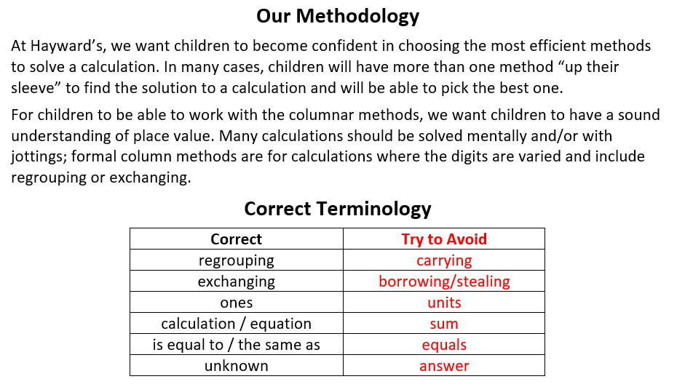

Slide 8
The importance of knowing key number facts and then slowing down and thinking
What do you notice?
What is the same?
What is different?
How has that changed?
What is the link between that?
Which one do you think is hardest/easiest – why?
What did you do to reach that solution?

Slide 9
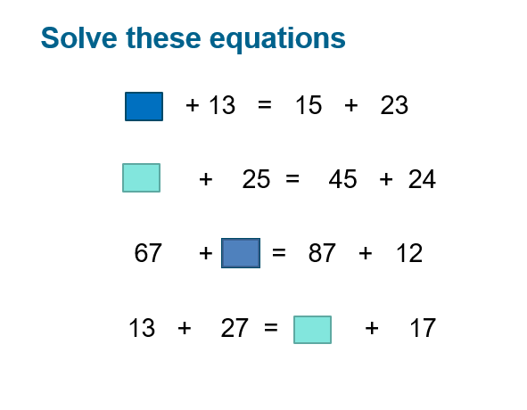

Slide 10
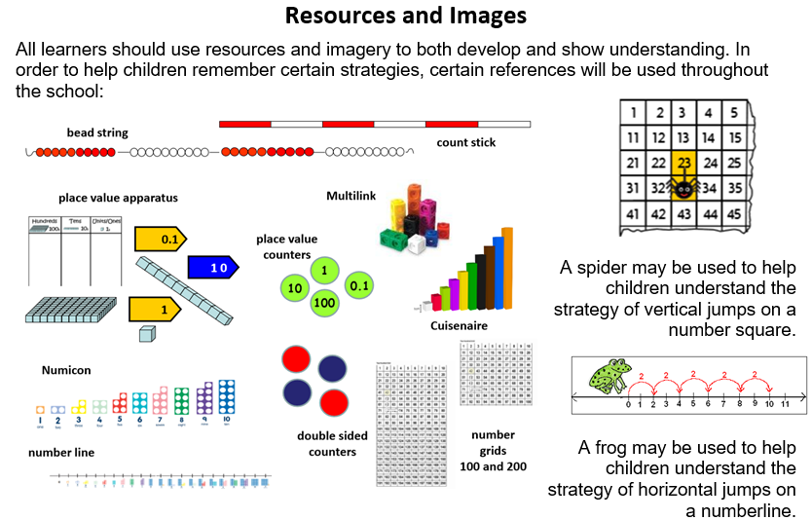
Apparatus, resources and imagery for all learners
SHOW IT
DRAW IT
EXPLAIN IT
TELL IT

Slide 11
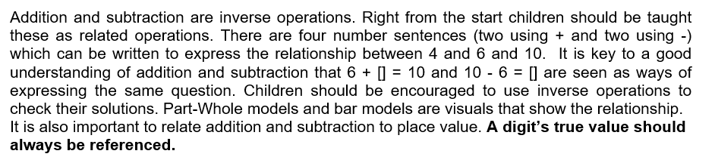
Key language for addition: sum, total, parts and wholes, plus, add, altogether, more, ‘is the same as’
Key language for subtraction: take away, subtract, find the difference, fewer, less than

Slide 12
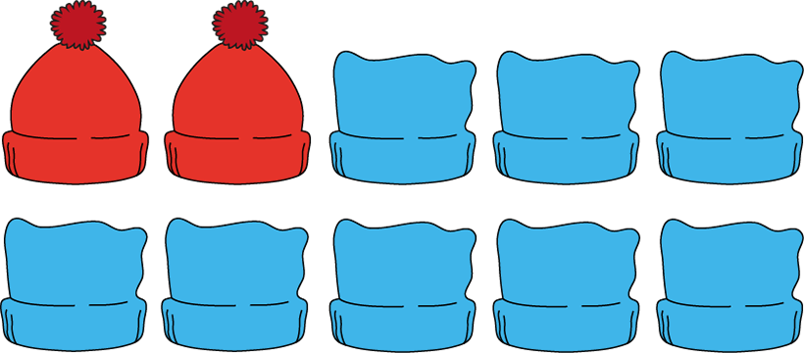

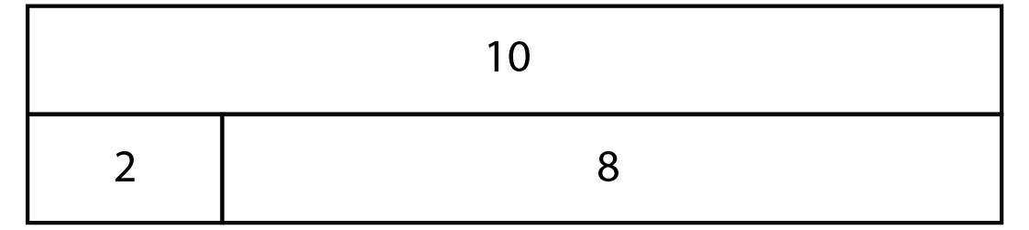
?
?
Notes:
12

Slide 13
10
10
10
5
1
2
8
3
9
3
2
5
3
2
4
10
8
Notes:
13

Slide 14
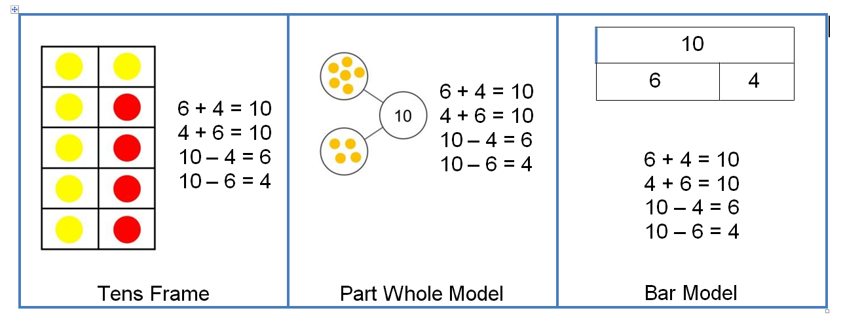
Using other structured models such as tens frames, part whole models or bar models can help children to reason about mathematical relationships.
Connections between these models should be made, so that children understand the same mathematics is represented in different ways. Asking the question “What’s the same what’s different?” has the potential for children to draw out the connections.

Slide 15

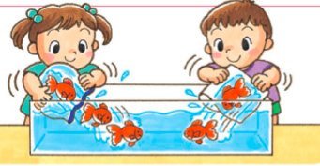
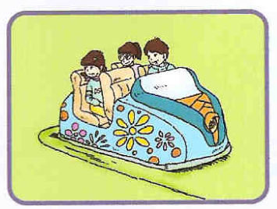
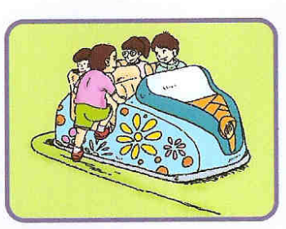
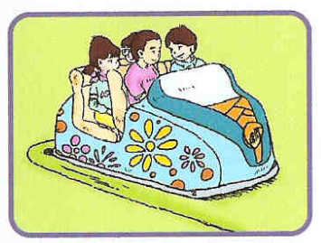
aggregation
partitioned set
What’s the same?
What’s different?
Can you write your own story for each type of addition?
augmentation

Slide 16
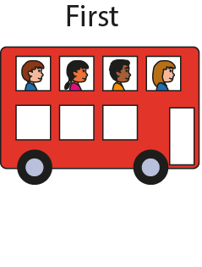
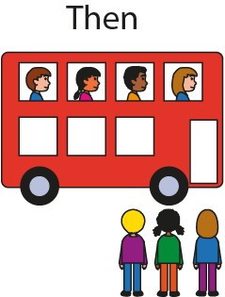
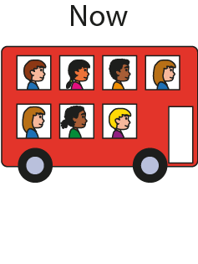



Augmentation
Notes:
16

Slide 17
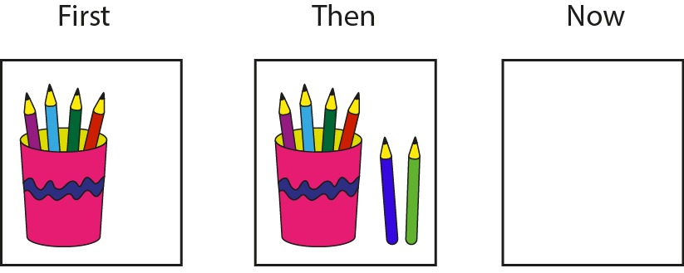





?
?
6
?
6
Notes:
17

Slide 18
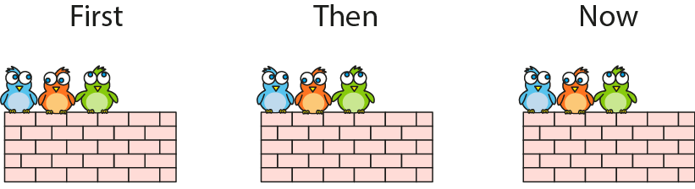

Notes:
18

Slide 19
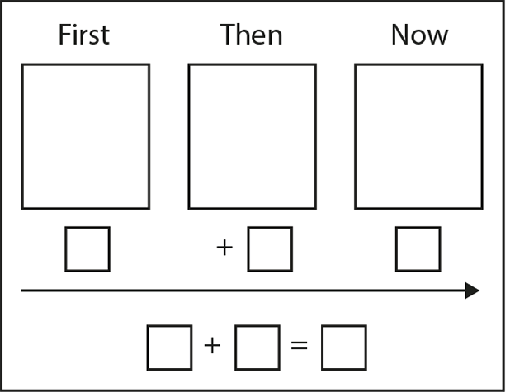
Notes:
19

Slide 20
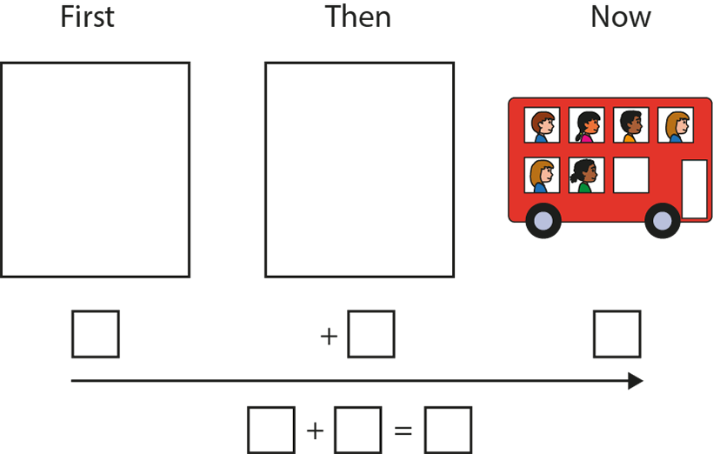
Can you write a story that ends with six children on the bus?
Notes:
20

Slide 21
Making 10 and Bridging 10

Slide 22
Bridging 10
What is the Calculation?
How can we use 10 to solve the addition problem?

Slide 23
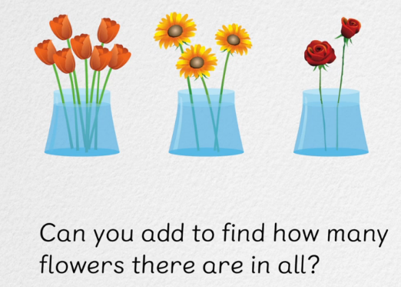
Adding 3 Numbers

Slide 24
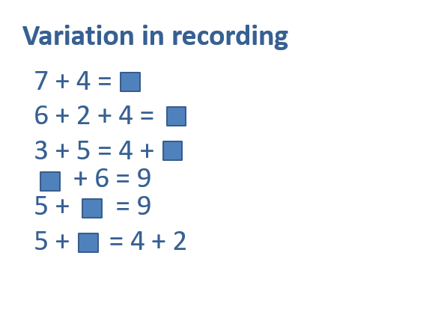

Slide 25
Place value and column value
34 = 30 and 4
34 = 3 tens and 4 ones

Slide 26
Using nouns to build understanding
Why does 30+40 =70?
3 tens plus 4 tens equals 7 tens
(3 flowers plus 4 flowers equals 7 flowers
3 ones plus 4 ones equals 7 ones)

Slide 27
Part/Part/Whole Model
9
10
2
?
7
10
5
Notes:
Try some
Part/part/whole - partitioning
27

Slide 28
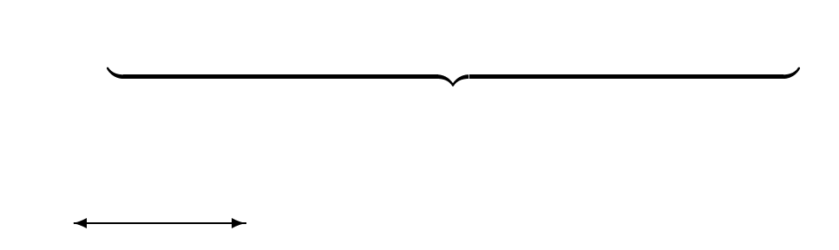
Bar model – part/part/whole
4
6
10
3
7
?
11
?
12
?
6
23
12
?
?
28

Slide 29
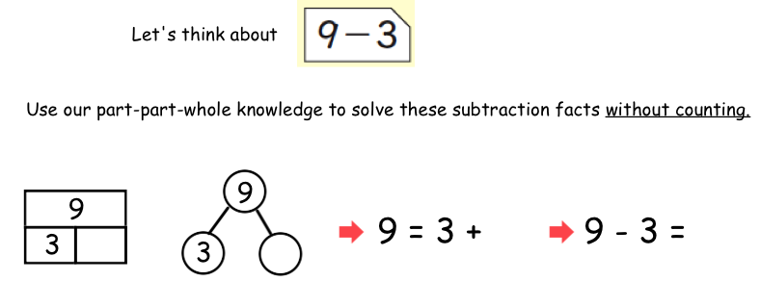

Slide 30
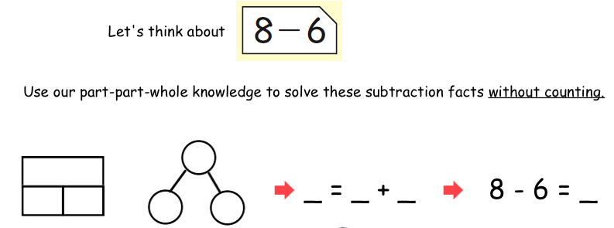

Slide 31
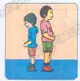
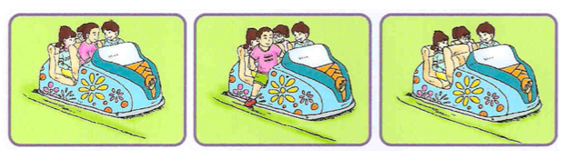
difference
aggregation
130 cm
150 cm
partition
What’s the same?
What’s different?
take away

Slide 32
Structures
Take Away
Difference
Partitioning

Slide 33
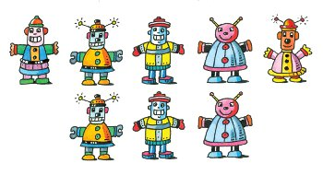



Slide 34
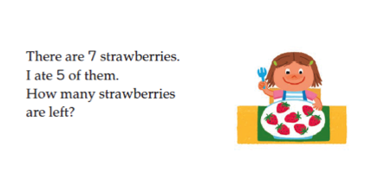
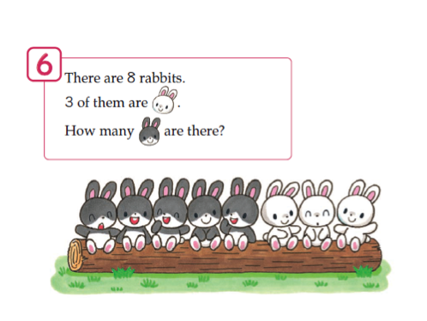
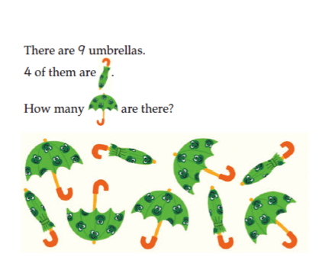

Slide 36
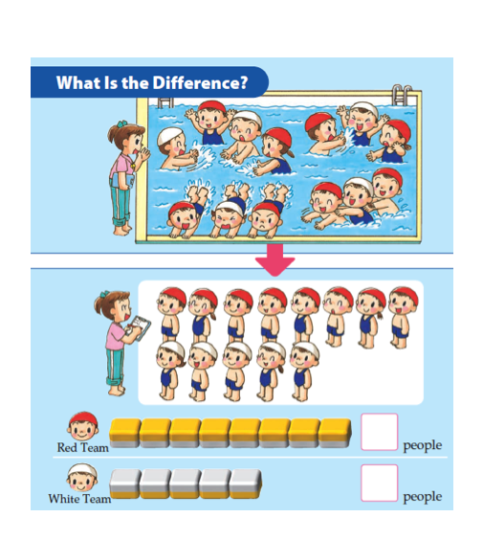
What do each of the counters represent?

Slide 37
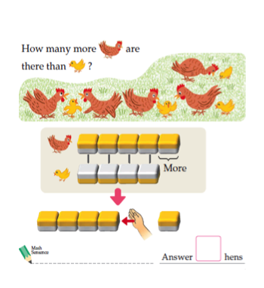
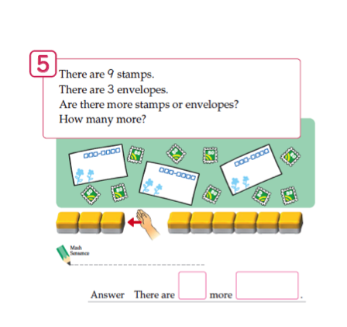
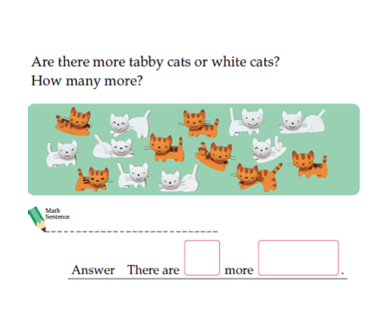

Slide 38
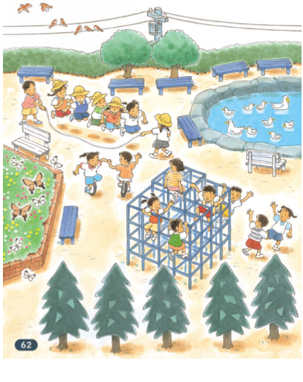
Can you see all three structures in this picture?

Slide 39
Which strategy would you use?
65 – 59 =
87 – 23 =
? = 90 – 30
50 – 37 =

Slide 40
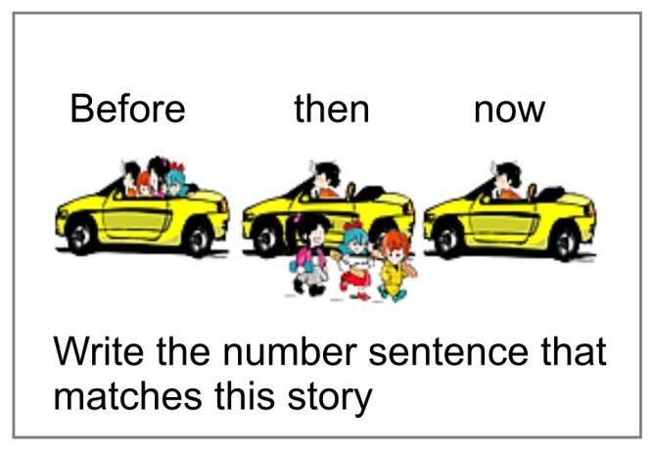
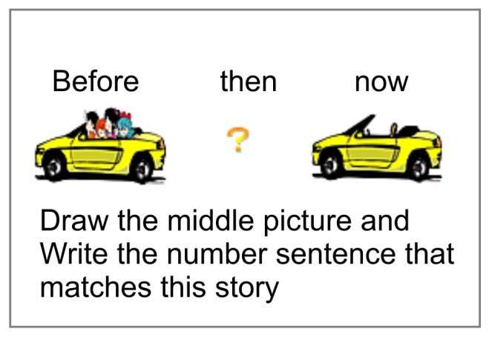
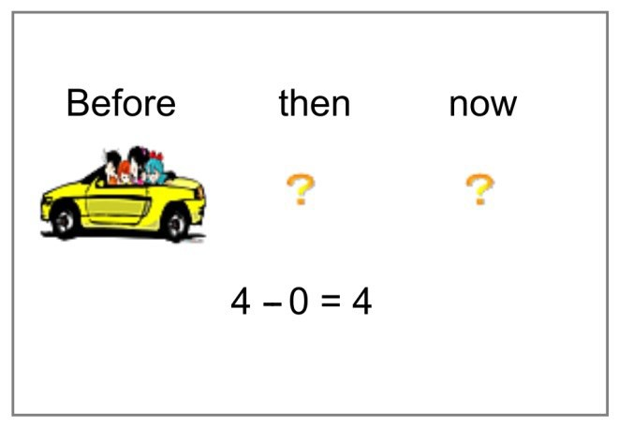
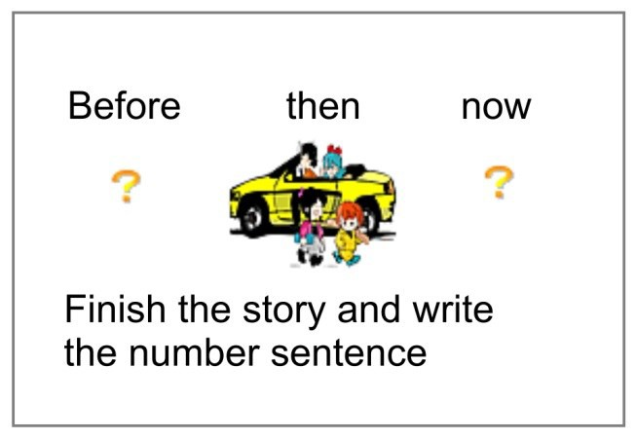
Move between Concrete and Abstract

Slide 41

More Complex Number Sentences

Slide 42
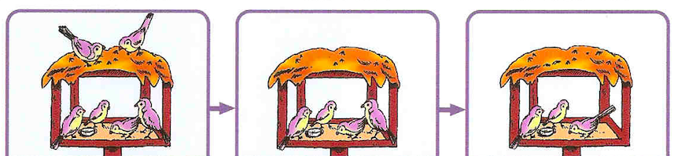
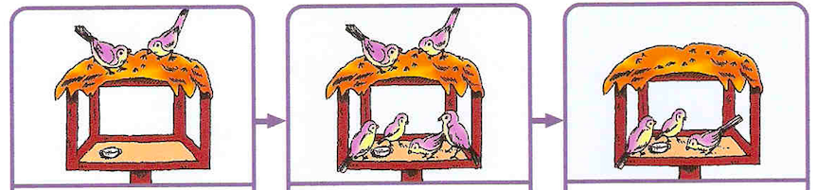
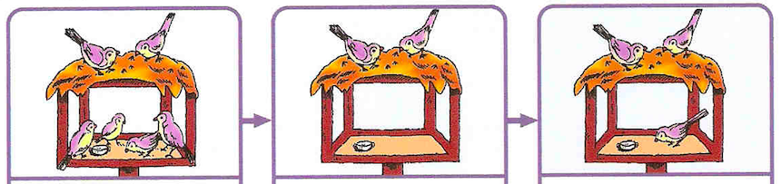

Slide 43
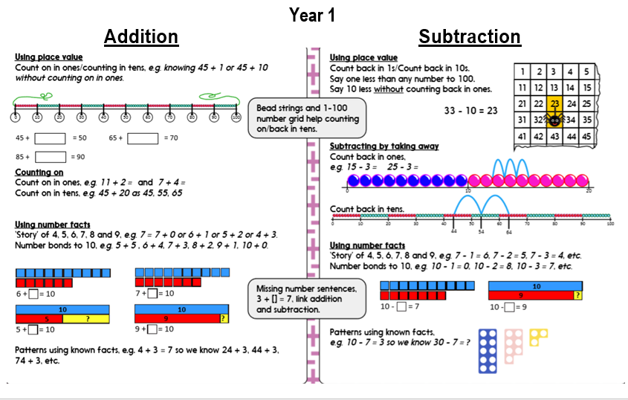

Slide 44
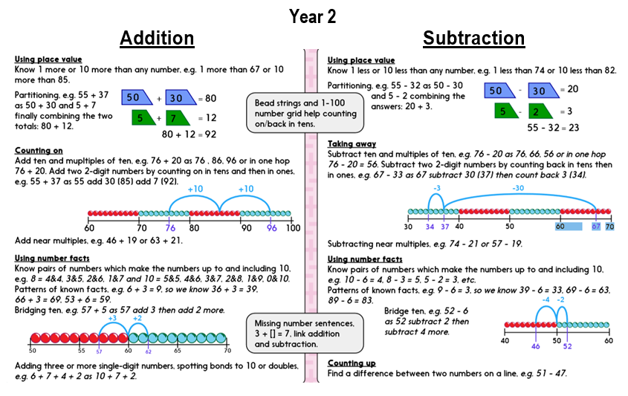

Slide 45
What would be considered an efficient calculation method to solve this calculation?
___ = 34 + 57
19 – 16 = ___
36 – 5 =
70 = 30 + ____

Slide 46
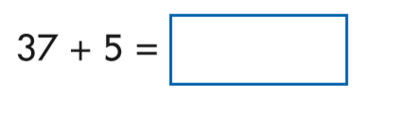
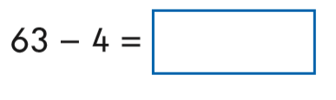
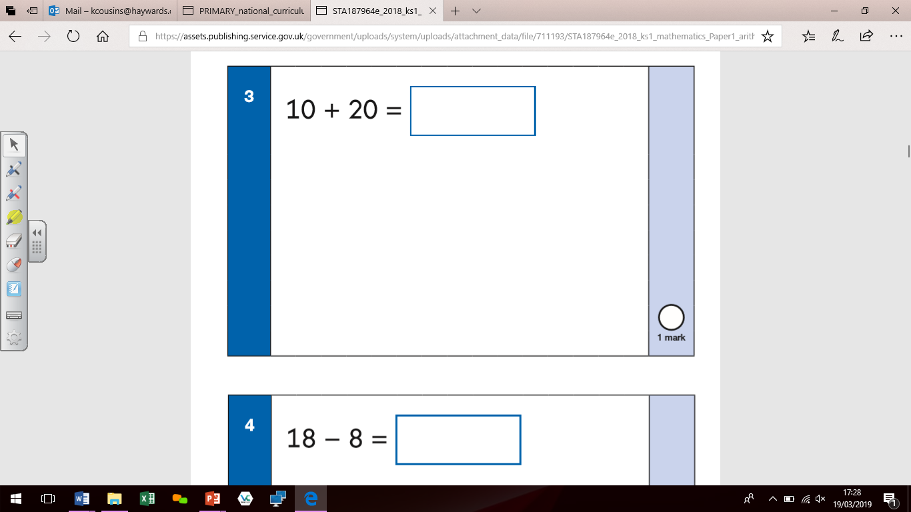
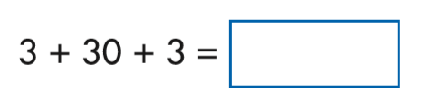
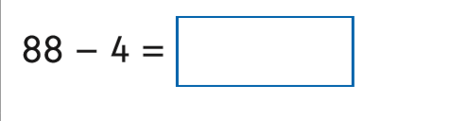
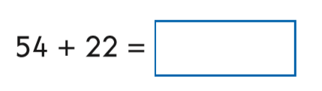
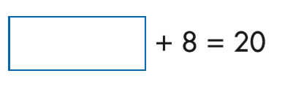
What is expected at the end of KS1?

Slide 47


What is expected at the end of KS1?
Applying the Skills in Context

Slide 48


What is expected at the end of KS1?
Applying the Skills in Context

Slide 49
Thank you for coming!

